Slide 1
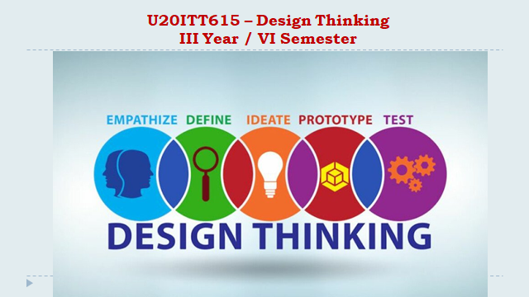
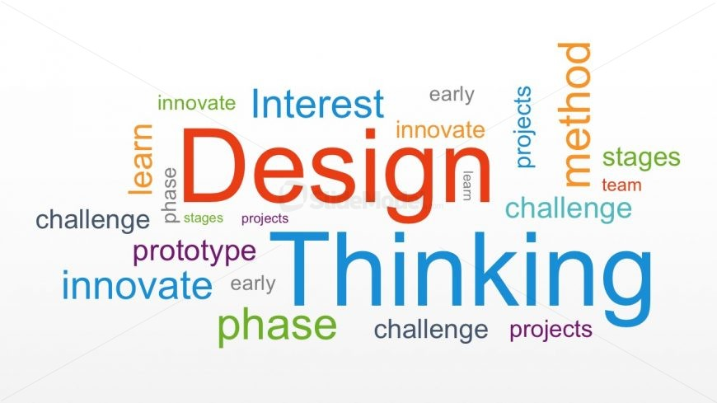
U20ITT615 – Design Thinking III Year / VI Semester N. Kalaiselvi, Assistant Professor, Department of IT,SMVEC

Slide 2
Course Outcomes
CO1 - Explain the fundamentals of Design Thinking and innovation. (K2)
CO2 - Empathize and analyze model action plan. (K2)
CO3 - Describe the principles of innovation and idea generation for product design. (K2)
CO4 - Apply design thinking techniques for given tasks. (K3)
CO5 - Apply the design thinking techniques for solving problems in various sectors. (K3)

Slide 3
Syllabus
UNIT I INTRODUCTION TO DESIGN
Introduction to elements and principles of Design, basics of design-dot, line, shape, form as fundamental design components. Principles of design - Introduction to design thinking - history of Design Thinking - New materials in Industry.
UNIT II- DESIGN THINKING
Design thinking process (empathize, analyze, idea & prototype), implementing the process in driving inventions, design thinking in social innovations. Tools of design thinking - person, costumer, journey map, brain storming, product development.
UNIT III- INNOVATION AND PRODUCT DESIGN
Art of innovation, Difference between innovation and creativity, role of creativity and innovation in organizations. Creativity to Innovation. Teams for innovation, Measuring the impact and value of creativity. Problem formation, introduction to product design, Product strategies, Product value, Product planning, product specifications
UNIT IV – DESIGN THINKING FOR STRATEGIC INNOVATION
An exercise in design thinking – implementing design thinking for better process. Implement design thinking process in various Industries. Design thinking for Startups.
UNIT V – DESIGN THINKING IN VARIOUS SECTORS
Case studies in Information Technology, Finance, Education, Management and Retail sector. Analyze and Prototyping, Usability testing, Organizing and interpreting results

Slide 4
Text Books and References
Text Books:
Change by design, Tim Brown, Harper Bollins(2009)
Design thinking in the Class Room by David Lee, Ulyssespress.
Product Design and Manufacturing by A.K. Chitale and R.C. Gupta, PrenticeHall
Reference Books:
Design the Future , by Shrrutin N Shetty , NortonPress
Universal principles of design- William lidwell, kritina holden, Jillbutter.
The era of open innovation –chesbrough.H
Websites:
https://drive.google.com/file/d/1cplqb1eOWnoNMhFWNP8TyYLF2qHdGY_K/view
https://nptel.ac.in/courses/110/106/110106124/#

Slide 5
UNIT II
UNIT II - DESIGN THINKING
Design thinking process (empathize, analyze, idea & prototype)
implementing the process in driving inventions
design thinking in social innovations.
Tools of design thinking - person, costumer, journey map, brain storming
product development.

Slide 6
Design Thinking Process
Design thinking is a non-linear, iterative process that teams use to understand users, challenge assumptions, redefine problems and create innovative solutions to prototype and test.
Involving five phases
Empathize,
Define,
Ideate,
Prototype and
Test

Slide 7
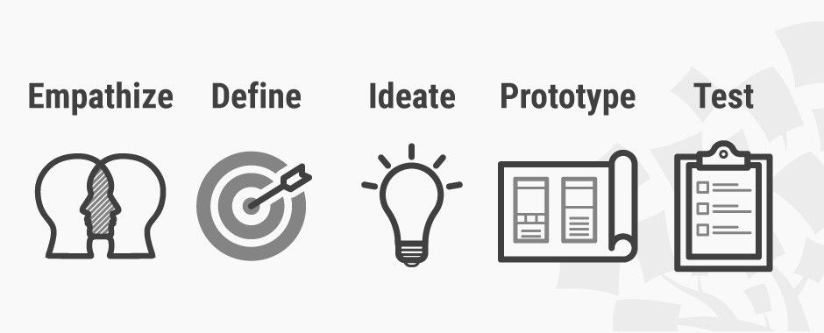
Introduction to design thinking
The Five Stages of Design Thinking
Stage 1: Empathize—Research Your Users' Needs.
Stage 2: Define—State Your Users' Needs and Problems.
Stage 3: Ideate—Challenge Assumptions and Create Ideas.
Stage 4: Prototype—Start to Create Solutions.
Stage 5: Test—Try Your Solutions Out.

Slide 8
The Five Stages of Design Thinking
Stage 1: Empathize—Research Your Users' Needs.
Here, you should gain an empathetic understanding of the problem you’re trying to solve, typically through user research.
Empathy is crucial to a human-centered design process such as design thinking because it allows you to set aside your own assumptions about the world and gain real insight into users and their needs.
Stage 2: Define—State Your Users' Needs and Problems
It’s time to accumulate the information gathered during the Empathize stage.
You then analyze your observations and synthesize them to define the core problems you and your team have identified. These definitions are called problem statements.
You can create personas to help keep your efforts human-centered before proceeding to ideation.

Slide 9
The Five Stages of Design Thinking
Stage 3: Ideate—Challenge Assumptions and Create Ideas
Now, you’re ready to generate ideas.
The solid background of knowledge from the first two phases means you can start to “think outside the box”, look for alternative ways to view the problem and identify innovative solutions to the problem statement you’ve created.
Brainstorming is particularly useful here..
Stage 4: Prototype—Start to Create Solutions
This is an experimental phase. The aim is to identify the best possible solution for each problem found.
Your team should produce some inexpensive, scaled-down versions of the product (or specific features found within the product) to investigate the ideas you’ve generated. This could involve simply paper prototyping.
Stage 5: Test—Try Your Solutions Out
Evaluators rigorously test the prototypes. Although this is the final phase, design thinking is iterative: Teams often use the results to redefine one or more further problems.
So, you can return to previous stages to make further iterations, alterations and refinements – to find or rule out alternative solutions

Slide 10
Implementing Design thinking in Driving innovations
The biggest driving force is the accelerated rate of change in business and society caused by advances in technology.
As companies become more software-driven, and the rate of change increases, so does complexity.
Most companies are optimised to execute and solve a stated problem. Creativity is about finding the problem worth solving.
An absence of a scalable creative framework encourages incremental innovation in lieu of disruptive innovation. As companies strive for disruptive innovation, they must find ways to inject and scale creativity across their organizations.
Design thinking is our best tool for sense-making, meaning making, simplifying processes, and improving customer experiences. Additionally, design thinking minimises risk, reduces costs, improves speed, and energises employees

Slide 11
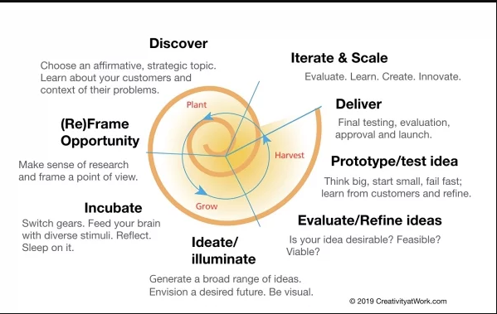
Creativity at Work Design Innovation Protocol

Slide 12
Four critical factors when implementing design thinking
1. Leadership: Link design thinking initiatives to your strategic goals.Provide direction, resources, and commitment.
2. People: Enable champions to lead the change through successful lighthouse projects. Build up an internal design thinking community where best practices are shared.
3. Process: Use the generic design thinking framework, but evolve the method and tools so they support your company’s objectives.
4. Environment: Develop and create collaborative workspaces for your workforce. Use to co-innovate with your customers and partners.
Design thinking works because it is a collaborative co-creative process grounded in engagement, dialogue, and learning. When you involve customers and/or stakeholders in the process of defining the problem and in developing solutions, you have a much better chance of gaining commitment for change, and getting buy-in for your innovation.

Slide 13
Four steps to highlight the benefits of the design thinking tools in your company
1. Focus on the problem
Companies often fail at effectively solving problems or meeting goals because they don’t correctly identify the user or problem initially. Here are a few tips for identifying your problem:
Listen. Put yourself in users’ shoes and think through their lenses.
Ask questions. Who encounters this problem and why? Why did past attempts fail to solve the problem at hand?
Have collaborative conversations. Engage with everyone, not just those on your team.
Stay unbiased. Don’t assume you immediately understand the problem, nor the solution. By being open-minded you might find something else you weren’t expecting.

Slide 14
Four steps to highlight the benefits of the design thinking tools in your company
2. Develop design thinking skills on your team
Traditionally, the ideation phase of the design thinking process was saved for project managers or engineers, but that doesn’t mean it can only be used by that department or function. Since design thinking is the mindset of asking questions, understanding, and testing, everyone can and should participate in this practice. Here are a few tips for developing your team’s design thinking skills:
Practice the mindset. Start implementing the process in your role whenever you can. For example, if you oversee onboarding, think about ways you can test a new approach or understand the new employee mentality by gathering feedback through a survey. Remain open to new outcomes.
Foster interests in design thinking. If you have team members who want to take initiative and expand their skill sets, make sure to nurture that interest, whether it is encouraging experimentation or reimbursing costs for design thinking classes.

Slide 15
Four steps to highlight the benefits of the design thinking tools in your company
3. Have (or start having) more debriefs
It’s important to understand that design thinking is continuous. It’s a process of iterating on previous experiments so that the product or outcome can improve and become better. However, learnings can’t be implemented if there’s no feedback process. Here are a few tips for creating a learning culture through gathering feedback:
Be open about what went wrong. Set an example by demonstrating that failure is an expected part of design thinking. Openly discuss what tests failed and why.
View failure as learning. Trying and failing a new approach serves the crucial function of narrowing down the list of possible processes. This gets you and your team closer to the approach that will work best. Encourage failure!
4. Embrace the feedback loop
The goal of design thinking isn’t perfection, but the best answer possible. And the best answer likely won’t be the first answer. Thus, a constant feedback loop is essential. Here are some tips for implementing a feedback loop:
Test and iterate as much as possible. Find new ways and angles to test your assumptions, you might come across something you would’ve never thought of otherwise.
Have feedback sessions often. When you embrace feedback, not only does it create a safe space to innovate but it also prevents the same mistakes from happening again.

Slide 16
Implementing Design thinking in Driving innovations
What will be the advantages?
Using design thinking to innovate will improve a lot of thing for your business like:
Quality of products
Reduce costs
Competitive advantage
Higher profits
Businesses that fail to innovate, run the risk of:
Losing market share to competitors
Falling productivity and efficiency
Losing people who are keen on innovation
Experiencing steadily reducing profits
Going out of business

Slide 17
design thinking results and solutions
The process is like a muscle that you need to build and use. With a design thinking mindset, you can spend time effectively solving the right problems and building processes that will impact your organization’s success.
Design thinking is both an ideology and a process that seeks to solve complex problems in a user-centric way. It focuses on achieving practical results and solutions that are:
Technically feasible: They can be developed into functional products or processes;
Economically viable: The business can afford to implement them;
Desirable for the user: They meet a real human need.

Slide 18
Design Thinking - Social Innovation
Design thinking is not just a buzzword or a trendy concept—it holds significant importance when it comes to solving social problems. Here are some key reasons why applying design thinking to address social issues is crucial:
Human-Centered Solutions:
Design thinking puts people at the heart of the problem-solving process. By empathizing with the individuals affected by social problems, designers gain deep insights into their needs, aspirations, and challenges. This understanding allows for the development of solutions that are truly tailored to address the underlying causes and improve people’s lives. Design thinking ensures that the solutions created are not just band-aid fixes but transformative and sustainable changes.
Creative Problem-Solving
Social problems are often complex and multifaceted, requiring innovative approaches. Design thinking encourages thinking outside the box and fosters a culture of creativity. By approaching problems from new angles and combining diverse perspectives, design thinkers can generate novel and unconventional solutions. It breaks free from the constraints of traditional problem-solving methods and enables fresh ideas to emerge, leading to breakthrough innovations.

Slide 19
Design Thinking - Social Innovation
Iterative and Agile Approach
Design thinking is an iterative process that encourages continuous learning and improvement. By prototyping and testing solutions early on, designers can gather feedback and refine their ideas based on real-world insights. This agile approach allows for rapid experimentation and course correction, ensuring that solutions are adaptive and responsive to evolving needs. It minimizes the risks associated with implementing large-scale interventions without real-world validation.
Collaboration and Co-Creation
Social problems are often complex and require a multidisciplinary approach. Design thinking fosters collaboration among diverse stakeholders, including experts, community members, policymakers, and organizations. This collaborative environment promotes collective intelligence and leverages the expertise and perspectives of various stakeholders. By involving those affected by the problem in the design process, it empowers communities and ensures that solutions are inclusive, contextually relevant, and sustainable.
Scalability and Impact
Design thinking not only aims to solve immediate social problems but also focuses on scalability and long-term impact. By testing and refining solutions iteratively, designers can identify the most effective approaches and develop strategies for scaling them up. The emphasis on measuring impact and continuous evaluation ensures that solutions are evidence-based and outcomes-driven. Design thinking enables social interventions to have a broader reach and create lasting change in communities and societies.

Slide 20
Design Thinking - Social Innovation
APPLYING DESIGN THINKING TO SOCIAL PROBLEMS
Let’s apply all 5 stages of design thinking to solve social problems and see how these work:
Identifying and Understanding Social Problems
In order to effectively address social problems using design thinking, it is crucial to begin by identifying and understanding the issues at hand. This stage sets the foundation for the entire problem-solving process and ensures that solutions are rooted in a deep understanding of the problem’s context and complexity. Here are key steps involved in identifying and understanding social problems through a design thinking lens:
Researching and Gathering Insights:
Thorough research is essential to gain a comprehensive understanding of the social problem being addressed. This involves conducting literature reviews, analyzing data, and studying existing reports and studies related to the issue. By immersing themselves in existing knowledge and understanding the broader context, designers can uncover valuable insights that inform their problem-solving approach.

Slide 21
Design Thinking - Social Innovation
2. Engaging with Stakeholders and Affected Communities: Effective problem-solving requires active engagement with stakeholders and the communities affected by the social problem. This includes individuals who directly experience the issue, as well as experts, policymakers, and organizations working in the field. By listening to diverse perspectives, designers can gain a more nuanced understanding of the problem’s causes, impacts, and potential solutions. Engaging with stakeholders also helps build trust, foster collaboration, and ensure that the proposed solutions are aligned with the needs and aspirations of the community.
3. Empathizing with the Target Audience: Empathy lies at the core of design thinking. To truly understand a social problem, designers need to develop a deep sense of empathy towards the people impacted by it. This involves putting themselves in the shoes of the individuals experiencing the problem, listening to their stories, and observing their experiences firsthand. By empathizing with the target audience, designers can uncover hidden needs, emotions, and barriers that influence the problem and its potential solutions.

Slide 22
Design Thinking - Social Innovation
4. Defining the Problem: Once a thorough understanding of the social problem has been established, designers need to define the problem statement clearly and concisely. This involves identifying the root causes, underlying factors, and systemic issues that contribute to the problem. The problem definition should be focused, actionable, and framed in a way that inspires creative ideation and solution development. A well-defined problem statement acts as a guiding beacon throughout the design thinking process.

Slide 23
Design Thinking - Social Innovation
Empathizing with the target audience
Empathy is a cornerstone of design thinking, and it plays a pivotal role in the process of solving social problems. To effectively address the needs and challenges faced by the target audience, designers must develop a deep sense of empathy. Here are key steps involved in empathizing with the target audience:
Active Listening: The first step in developing empathy is to listen actively and attentively. Designers engage in conversations with individuals who directly experience the social problem, giving them a platform to share their stories, perspectives, and emotions. By truly hearing their voices and experiences, designers can gain a more profound understanding of the lived realities and unique circumstances of the target audience.
Immersion and Observation: Empathy goes beyond just listening—it involves immersing oneself in the environment and context of the target audience. Designers spend time in the communities affected by the social problem, observing and experiencing firsthand the challenges, resources, and constraints faced by individuals. This immersive approach provides designers with rich insights and helps them uncover nuances that may not be evident through interviews alone.

Slide 24
Design Thinking - Social Innovation
Building Trust and Relationships: Empathy flourishes within a trusting and respectful relationship. Designers aim to build rapport and trust with the target audience, ensuring that individuals feel comfortable sharing their experiences and perspectives openly. Trust allows for deeper conversations and a greater level of insight into the needs, motivations, and aspirations of the community members.
Practicing Empathy Tools and Techniques: Designers employ various tools and techniques to foster empathy. These may include storytelling, role-playing, journey mapping, or creating empathy maps. Such methods help designers step into the shoes of the target audience, seeing the world through their eyes and understanding their feelings, thoughts, and challenges more profoundly.
Avoiding Assumptions and Biases: Empathy requires designers to set aside preconceived notions and biases. It is essential to approach the target audience with an open mind and without judgment, recognizing that each person’s experience is unique. By avoiding assumptions, designers can genuinely understand the complexity and diversity within the target audience.

Slide 25
Design Thinking - Social Innovation
Defining the problem
Once designers have empathized with the target audience and gained insights into the social problem, the next step in the design thinking process is to define the problem. This stage involves distilling the gathered information and observations into a clear and actionable problem statement. Here’s how designers define the problem:
Synthesizing Insights: Designers review and synthesize the data, information, and observations collected during the empathy stage. They look for patterns, themes, and commonalities among the experiences and needs of the target audience. By organizing and analyzing the data, designers gain a comprehensive overview of the problem landscape.
Identifying Root Causes: In addition to understanding the surface-level symptoms of the social problem, designers delve deeper to identify the underlying root causes. They investigate the systemic factors, societal norms, and structural barriers that contribute to the persistence of the problem. This analysis helps designers uncover the core issues that need to be addressed for effective problem-solving.

Slide 26
Design Thinking - Social Innovation
Framing the Problem Statement: Designers distill their findings into a clear problem statement that encapsulates the essence of the social problem. The problem statement should be focused, specific, and actionable. It should describe the problem in a way that inspires creative ideation and solution development. A well-defined problem statement acts as a guiding North Star throughout the design thinking process, ensuring that designers stay on track and aligned with the ultimate goal.
Applying the “How Might We” Technique: To frame the problem statement in an open and solution-oriented manner, designers often use the “How Might We” (HMW) technique. By posing the problem as a question, such as “How might we address X challenge to achieve Y impact?” or “How might we improve Z to better serve the target audience?” designers encourage brainstorming and ideation around potential solutions.
Refining and Iterating: Defining the problem is not a one-time activity. Designers continuously refine and iterate the problem statement as they gain more insights and progress through the design thinking process. They remain open to feedback, adjust their understanding of the problem, and refine the problem statement to ensure its accuracy and relevance.

Slide 27
Design Thinking - Social Innovation
Ideation and Prototyping
After empathizing with the target audience and defining the problem, the design thinking process moves into the ideation and prototyping stage. This stage is all about generating a wide range of creative ideas and exploring different possibilities. Here are key aspects of ideation and prototyping in design thinking:
Generating a Wide Range of Creative Ideas: Designers aim to generate as many ideas as possible during the ideation phase. The focus is on quantity and diversity, encouraging a free flow of creative thinking. By suspending judgment and embracing wild and unconventional ideas, designers open up new possibilities and break away from traditional solutions.
Brainstorming Techniques and Ideation Exercises: Brainstorming is a popular technique used to generate ideas in design thinking. It involves a group of individuals coming together to generate ideas through a free-flowing and non-judgmental process. Brainstorming sessions can be facilitated using various methods, such as mind mapping, random word associations, or the SCAMPER technique (Substitute, Combine, Adapt, Modify, Put to another use, Eliminate, Reverse).

Slide 28
Design Thinking - Social Innovation
Encouraging Diverse Perspectives and Collaboration: Design thinking recognizes the value of diverse perspectives and collaboration in ideation. By involving individuals with different backgrounds, expertise, and viewpoints, designers can tap into a collective intelligence that enriches the ideation process. Collaborative approaches such as co-creation workshops, interdisciplinary teams, and stakeholder engagement ensure that a wide range of insights and ideas are brought to the table.
Rapid Prototyping: Prototyping is a crucial part of the design thinking process. It involves creating tangible representations of ideas to bring them to life. Prototypes can take various forms, ranging from simple sketches and diagrams to physical models or interactive digital mock-ups. The goal is to create a visual or interactive representation that allows designers and stakeholders to experience and interact with the potential solution.

Slide 29
Design Thinking - Social Innovation
Prioritizing and selecting the most promising ideas
Once a multitude of ideas has been generated through the ideation and prototyping stage, the next step in the design thinking process is to prioritize and select the most promising ideas to move forward with. Here’s how designers make informed decisions in selecting ideas:
Evaluation Criteria: Designers establish evaluation criteria based on the problem definition and desired outcomes. These criteria help assess the feasibility, desirability, and viability of each idea. Common evaluation criteria may include alignment with user needs, potential impact, technical feasibility, resource requirements, and sustainability.
User-Centered Approach: Designers put the target audience at the center of the decision-making process. They refer back to the insights gained during the empathy stage and evaluate ideas based on how well they address the needs and aspirations of the users. By prioritizing user-centered solutions, designers ensure that the selected ideas have a higher chance of resonating with the intended audience.

Slide 30
Design Thinking - Social Innovation
Iterative Feedback: Designers seek feedback on the generated ideas from various stakeholders, including end-users, experts, and other relevant parties. This feedback helps refine and iterate the ideas, making them more robust and aligned with the identified problem. Regular feedback loops enable designers to gather valuable insights and perspectives that contribute to the selection process.
Impact and Feasibility Analysis: Designers conduct impact and feasibility analysis to assess the potential impact of each idea and its practicality in implementation. They consider factors such as the scalability of the solution, resource requirements, technical feasibility, regulatory constraints, and potential risks. This analysis helps identify ideas that have the highest likelihood of creating meaningful impact while being implementable within the given constraints.
Prioritization Techniques: Various prioritization techniques, such as the prioritization matrix or the impact-effort matrix, can be employed to rank and compare ideas systematically. These techniques assign weights or scores to different criteria and help designers objectively evaluate and compare ideas. The aim is to identify ideas that align well with the desired outcomes, have high potential impact, and are feasible to implement.
Iterative Refinement: The selection process is not a final decision but an ongoing refinement of ideas. Designers iterate on the ideas, incorporating feedback and insights gained during the selection process. This iterative refinement helps enhance the selected ideas and ensures that they evolve and improve over time.

Slide 31
Design Thinking - Social Innovation
Creating prototypes to bring ideas to life
Once the most promising ideas have been selected, the design thinking process moves into the stage of creating prototypes. Prototyping is a crucial step that allows designers to bring their ideas to life and test them in a tangible form. Here’s how designers create prototypes and iterate on their development:
Rapid Prototyping Techniques: Rapid prototyping techniques are employed to quickly create tangible representations of the selected ideas. These techniques focus on speed and efficiency, enabling designers to iterate rapidly and gather feedback early in the process.
Iterative Development and Refinement: Prototyping in design thinking is an iterative process that involves continuous development and refinement of the initial prototype. Through user testing and feedback, designers gather insights that inform subsequent iterations.

Slide 32
Design Thinking - Social Innovation
Testing and Iteration
The testing and iteration stage is a vital part of the design thinking process. It involves conducting user testing, collecting feedback, and using that feedback to improve prototypes. This iterative approach ensures that the final design is user-centered and meets the needs of the target audience. Here’s how designers test, incorporate feedback, and refine their designs:
Define Testing Objectives: Designers establish clear objectives for the testing phase, identifying what aspects of the design they want to evaluate and gather feedback on. This helps focus the testing process and gather relevant insights.
Create Testing Scenarios: Designers develop scenarios or tasks that users will perform with the prototype. These scenarios should be designed to test specific features, functionalities, or user interactions. The scenarios should resemble real-life situations as closely as possible.
Facilitate User Testing Sessions: Designers guide users through the testing process, providing instructions and clarifications when necessary. They observe and take notes on users’ actions, behaviors, and feedback during the testing session.
Collect Feedback: Designers gather feedback from users through various methods, such as surveys, interviews, or structured questionnaires. They encourage users to share their thoughts, impressions, likes, dislikes, and suggestions for improvement.

Slide 33
Design Thinking - Social Innovation
CASE STUDIES AND EXAMPLES
Design thinking has been successfully applied to solve various social problems, resulting in significant outcomes and positive impact. Let’s explore some notable case studies that highlight the successful applications of design thinking in addressing social issues:
Project H Design: Project H Design is a non-profit organization that applies design thinking to empower communities and address social challenges. They have implemented numerous projects, such as the Learning Landscape initiative, which transformed neglected public spaces into engaging learning environments for children. By involving local communities in the design process, Project H Design has created sustainable solutions that foster education, play, and community engagement.
IDEO.org’s Human-Centered Design Approach: IDEO.org, a leading design and innovation firm, has utilized human-centered design approaches to tackle social problems. For example, they collaborated with the Bill & Melinda Gates Foundation to redesign the sanitation experience for low-income communities in Kenya. By empathizing with users, they developed innovative toilet solutions that improved hygiene, reduced contamination, and positively impacted the health and well-being of individuals and communities.

Slide 34
Tools for Design Thinking - Persona
To create a successful product, you need a deep understanding of your customer’s needs.
This makes personas a critical component of the Design Thinking and UX design process.
Personas help designers, product teams, entrepreneurs, and innovators to:
Create a shared understanding of the end users’ goals.
Begin ideation with a focus on specific user goals.
Prioritize ideas and make decisions.
Critique and evaluate your designs.
Decide who to recruit for user research and testing.
They help you focus on creating solutions that have valid use cases for specific target audiences.
By understanding the purpose of personas and how they’re used, you can leverage this powerful tool to create meaningful experiences for your users.

Slide 35
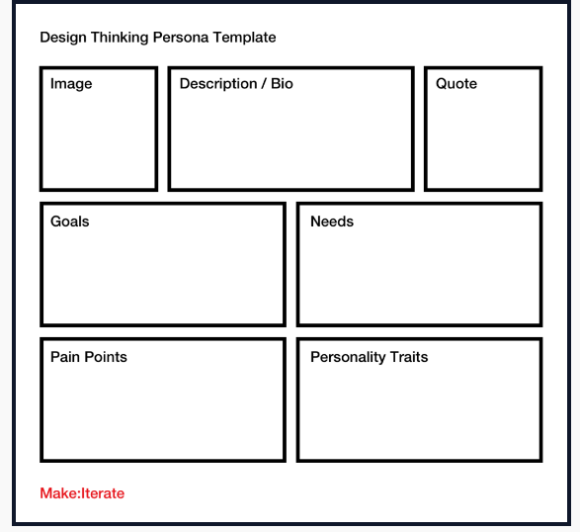
Tools for Design Thinking - Persona
What Are Personas?
A user persona is a document describing a user segment’s needs, behaviors, and demographic information.
They provide a deeper understanding of user behavior and needs so that we can make better human centered decisions during a design thinking project.
Personas represent an archetype of a user segment based on user research data.
They are created by researching user demographics and behavior, such as their interests, habits, goals, challenges, motivations, and pain points.

Slide 36
Tools for Design Thinking - Persona
Characteristics of a Good Persona
A good user persona should be detailed, realistic, and relatable.
It should represent a real user group and describe actual user needs based on evidence.
It should provide clear insights into who the users are, their motivations, goals, and needs, and how they interact with the product.
Additionally, user personas should be based on real data obtained through in-depth user research, interviews, surveys, and other feedback methods.
A good user persona should be based on user research and data.
A good user persona should be detailed and specific.
A good user persona should be realistic and represent a real person.
A good user persona should be actionable and help guide the product team.

Slide 37
Tools for Design Thinking - Persona
How to Use Personas in Design Thinking?
personas provide a valuable tool for critiquing and evaluating concepts during all stages of product development, ensuring a final design is user-friendly and meets business objectives.
1. Create a shared understanding of the end users’ goals
A user persona – along with an empathy map and customer journey map – helps to align the user experience design and product management team around a shared vision.
It helps them to understand the user needs of the primary persona and what complex problems need to be solved.
A persona should provide all of the necessary context that helps teams to create an innovative solution.

Slide 38
Tools for Design Thinking - Persona
2. Decide who to recruit for user research and testing.
Each persona group should help you develop criteria for who you need to recruit for research. You can also use this information later in the process when you need to recruit participants for user testing when you start getting feedback on your prototype.
3. Begin ideation with a focus on specific user goals
A good user persona can be an excellent starting point for ideation. You can use the different insights contained in the persona as inspiration to generate and develop a creative solution that aligns with a real person’s user story, goals, and motivations.
4. Prioritize ideas and make decisions
Whenever you need to make a design decision, you can refer back to the persona to ensure you’re basing your decisions on evidence. Whenever you encounter a tricky scenario or a difference in opinions.

Slide 39
Tools for Design Thinking - Persona
Different Types of Design Thinking Personas
The three main categories of user personas are proto-personas, qualitative, and quantitative personas.
Each has pros and cons, but the best personas will be quantitative and qualitative, as this will paint the most complete picture of your customers and their experiences.
1. Proto-personas
Proto-personas are lightweight, lean personas based on the design team’s existing knowledge or the assumptions and expertise already within the group. They’re a great way to start a project because they can help you to understand what you already know and where the knowledge gaps are.
As you progress through your design project, you can start to build on the proto-personas as you collect real evidence from your research. It’s important to acknowledge that since proto-personas contain some assumptions and unverified data points, any decisions made using them as a basis should be done so with caution.

Slide 40
Tools for Design Thinking - Persona
2. Qualitative personas
A qualitative persona is a detailed, data-driven representation of the end user. Unlike proto-personas, which are based on the assumptions and expertise of the design team, qualitative personas use a combination of different qualitative data points from user research to accurately reflect an individual’s behaviors, needs, goals, attitudes, and motivations.
3. Statistical personas
A statistical – or quantitative – persona is a type of user persona that uses data gathered from quantitative research methods such as surveys, analytics, and market research to determine the demographic attributes (such as age, gender, occupation, etc.) of the target audience.
4. Hybrid personas
The best personas will be a combination of qualitative and quantitative data points supporting each other to give a complete picture of the customer’s needs, motivations, attitudes, and behaviors.

Slide 41
Tools for Design Thinking - Persona
Steps to Creating User Personas With User Research
The first step is to gather data about your target users. This data can come from in-depth interviews, surveys, focus groups, or any other form of qualitative research.
Once you have this data, it’s crucial to analyze it and identify common user themes. The next step is to create a persona template that includes the following information: name, age, gender, job title, interests/hobbies, pain points, and needs/requirements.
Once the template is filled out, you can populate it with data from your research findings. This process should be repeated until you have several personas that represent your target audience accurately.

Slide 42
Tools for Design Thinking - Persona
Remember to keep them up-to-date as your design and development processes progress, so they always reflect the latest insights into your users’ behaviors and preferences.
1. Decide on which segment you want to learn more about
If you’re starting from scratch, you’ll need to first figure out which customer segment you want to learn more about. At this stage, you may know very little, so making some assumptions about who might benefit from or use your product is a good starting point.
2. Brainstorm questions that you can ask customers
Start by brainstorming a list of questions that will help you get the answers you need about your audience. Questions should help you clarify your customer segment’s needs, behaviors, and expectations. Some common questions you can ask people are:
Tell me about a recent experience you had with this product?
What was it you wanted to achieve?
Why was this important to you?
Did it meet your expectations?
The answers to these questions can then be used to fill out a persona template.

Slide 43
Tools for Design Thinking - Persona
3. Create surveys and conduct interviews to collect data
Now that you know who you want to speak to and what you want to ask them, you can create surveys and book participants for interviews.
The interviews will give you qualitative information that helps you to get a deep understanding of your users’ personal experiences.
The survey can help you to get an idea of customer preferences and behaviors and to quantify your findings from the interviews.
4. Analyze the findings to find common themes and patterns
Once you’ve finished your interviews and collected your survey responses. We need to collate all of the data, tag it so that we know where it came from, then go through an affinity mapping exercise to organize the data, make sense of it and find themes and patterns.
5. Organize your insights into a persona template
You need to take your findings and insights and map them to a persona template. By organizing your insights into motivational, attitudinal, and demographic information, you can paint a complete picture of who it is you’re designing for.

Slide 44
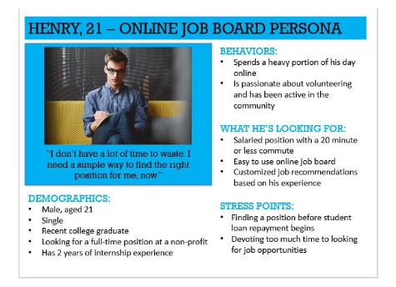
Tools for Design Thinking - Persona
Example

Slide 45
Tools for Design Thinking – Journey Map
Design thinking is a simple and effective way to find the right customer solution. It consists of empathizing deeply with the consumer, brainstorming potential solutions (no matter how out of the box they are) then testing and iterating on those ideas until you find a good solution.
Empathy Maps vs Journey Maps
In recent years empathy maps and journey maps have gained popularity due to the fact they are an upgrade and extension of personas. Personas are too empathy maps, what the internet is to our intellect. We have a base set of knowledge that we can store by default, but with the advent of the internet — and smartphones — we now treat the internet as a more detailed extension of our intellect.
We may not know the exact answer, but we know how to find it, yet the intellect would be rendered useless without our intellect as we would no longer be able to use it in the slightest. That is the relationship personas have with empathy and journey maps. They are not a replacement and they serve no purpose without the personas in place.

Slide 46
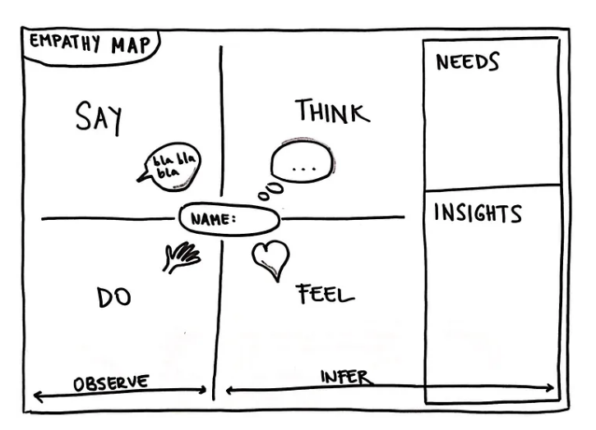
Tools for Design Thinking – Journey Map
Empathy Mapping
Empathy maps are deliverables that provide insight into what your persona says, does, thinks, and feels. Each of these are broken into quadrants that consist of the following.
Says
This portion consists of quotes of what the user has said aloud during interviews
Does
These are particular actions the user takes while using your product.

Slide 47
Tools for Design Thinking – Journey Map
Thinks
This section consists of what the user thinks during the entire process. Since humans have yet to be capable of reading minds, these “thoughts” are derived from insights gained during quantitative analysis. If you’re permitted to record the user — after filming — you can study their body language to harness insights as to what they are thinking as well as doing.
Feels
This section informs you of what the user is feeling and what is causing this i.e. Excited because they just won a prize
The significance of this mapping system is that it allows you to see conflicting information you may not otherwise acknowledge if not looked at closer. For example, say a user says they like how a screen looks, but while using it they have to execute the task multiple times. If you solely recorded that the user liked the UI or the user had trouble executing the task you would end up either leaving the page as is or revising the entire page. Whereas when you get the full picture you are then able to understand that the UI that has been designed is serving its visceral purpose, but not its behavioral purpose.

Slide 48
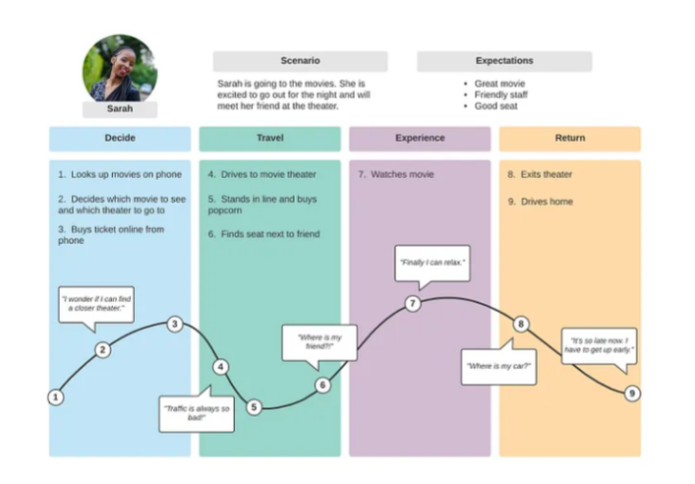
Tools for Design Thinking – Journey Map
A journey map is a detailed visualization that shows how a user-based persona is feeling throughout the process of using a particular product. When making a journey map always remember to cover these 5 key components.
Actors
An actor is a persona that the journey map is built around
Scenario and Expectations
The scenario sets the scene for this particular journey map, whereas the expectations are what the persona expects to take place. Expectations can be influenced by familiar mental models or marketing of the product [This is why marketing is a crucial aspect of the user experience].

Slide 49
Tools for Design Thinking – Journey Map
Actions, Mindsets, and Emotions
Actions, mindsets, and emotions are sorted across the different phases of the user journey.
Actions are all the tasks that make up each phase.
Mindsets are the thoughts, commentary, and concerns a user may externally express about each phase.
Emotions are represented by a curved line graph that goes up and down to communicate how happy or frustrated the user is with each phase of the journey. It’s common practice to plant emojis on the y-axis of the journey map to make it easy to understand the emotional state of the user across the whole journey.
Opportunities
After analyzing a user journey teams come up with where the user journey can improve[opportunities] and how it executes these improvements[internal ownership and metrics].
As you can start to see there is a fair amount of overlap between personas, empathy maps, and journey maps. Now that we’ve covered the basics let dive into the relationship between all these deliverables.

Slide 50
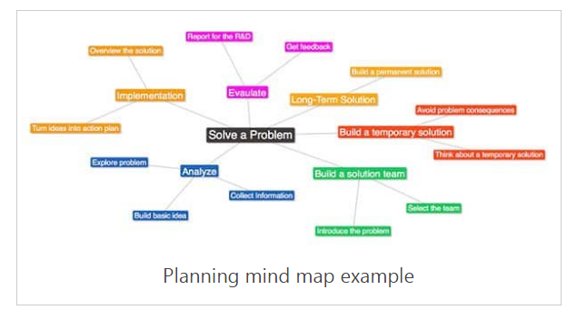
Tools for Design Thinking – Brainstorming
The brainstorming design thinking tools are when the team discusses different ideas and connect them to build a clear understanding of the connected elements in the situation.
A clear definition of the situation contributes to building several prototype solutions. It is crucial to understand that there should be no negative comments or judgment on presented ideas during the brainstorming sessions. The facilitator must keep the session neutral to avoid biases.

Slide 51
Tools for Design Thinking – Brainstorming
During brainstorming, the facilitator hands the attendees a pen and Post-its to write their ideas, and then they are added to a whiteboard. Each of the attendees starts to discuss their ideas with the group. As a result of these discussions, more ideas are discovered, which can also be added to the wall.
Reversed Brainstorming
When solving complex problems, the group may find defining or addressing ideas challenging. It is the point where there are no creative ideas, or the generated ideas are not efficient enough. One of the useful methods to overcome this situation is reversed brainstorming. In this tool, the group members reverse their mindset.

Slide 52
Tools for Design Thinking – Brainstorming
In the reversed brainstorming, the group members move between five main stages as follows:
Problem – In this stage, the team defines the problem that must be solved through the final product or service.
Reverse – The team reverses their mindset by thinking about how to make the problem worse.
Collect – The team starts brainstorming ideas that can make the problem worse and discuss with this approach in mind.
Reverse – The ideas are reversed to form solutions or suggest solutions for the problem.
Evaluate – The team evaluates the different solutions and sees if it works as a solution for the original problem. Note that the main idea of this stage is to check if the statements provide solutions for the issue after reversing it.

Slide 53
Tools for Design Thinking – Brainstorming
Design Thinking Tools for Evaluation
Sometimes, we need to evaluate situations using business tools or investigate the problem’s root cause based on the collected data. After brainstorming ideas, it is time to assess them and isolate the most efficient solutions to take to the next prototyping stage. While the brainstorming stage avoids judgment on the suggested ideas, the evaluation aims to evaluate and critique them.
SWOT Analysis
The SWOT Analysis is a method that allows you to evaluate ideas from four main perspectives; strength (S), weakness (W), opportunities (O) and threats (T). In this method, ideas are evaluated using the above four factors in order to understand their market viability.

Slide 54
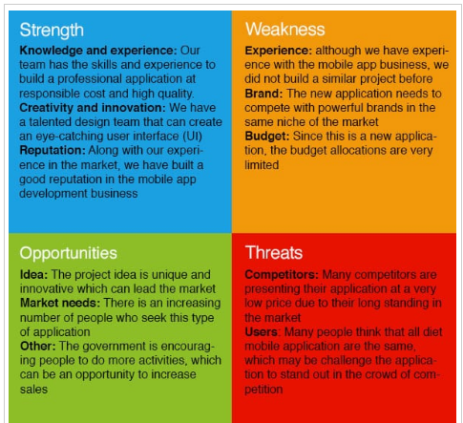
Tools for Design Thinking – Brainstorming
In this stage, the team investigates each idea based on those four dimensions, such as the following:
Strengths – What are the advantages of the new product or service?
Weakness – What are the factors that reduce your sales?
Opportunities – What are the opportunities for the new product?
Threats – Who are the existing or potential competitors?

Slide 55
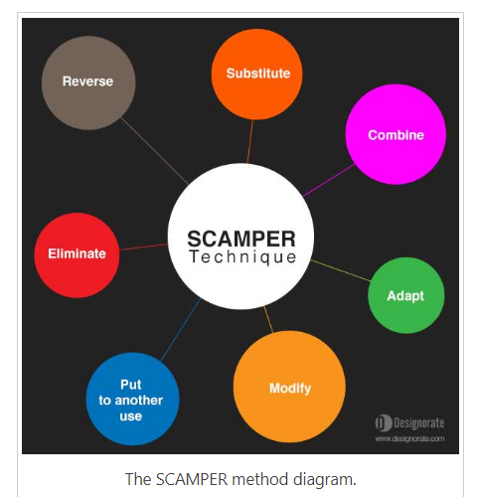
Tools for Design Thinking – Brainstorming
SCAMPER
The SCAMPER method examines the methods that may strengthen ideas based on seven factors; Substitute, Combine, Adapt, Modify, Put to other uses, Eliminate, and Rearrange. Unlike the SWOT analysis, the SCAMPER technique evaluates how an idea can be pushed further using the above factors. It provides a valuable tool for evaluating ideas and making them solid enough for the next stage

Slide 56
Tools for Design Thinking – Brainstorming
The team members evaluate each idea and brainstorm the potentials to make make it more successful in the market using each of the seven factors as following:
Substitute – The substitute technique focuses on the parts in the product, service or solution that can be replaced with another.
Combine – The combine technique tends to analyze the possibility of merging two ideas, stages of the process or product in one single more efficient output.
Adapt – Adapt refers to a brainstorming discussion that aims to adjust or tweak product or service for a better output.
Modify, minify or magnify – The modify technique refers to changing the process in a way that unleashes more innovative capabilities or solves problems.
Put to another use – This technique concerns how to put the current product or process for another purpose or how to use the existing product to solve problems.

Slide 57
Product Development
A product development process is the step-by-step procedure of all the actions needed to take a product from its initial concept to its market presence.
It typically consists of several phases in the complex process of delivering new products and transforming a product idea into marketable merchandise.
During the process, you start with an idea or concept and conclude with product specifications, a pricing strategy, service components, and distribution strategies. At its origin, this process must be idea-driven or market-driven!
The product development process aims to not only create something new but, above all, to maximize the product value and mitigate the risks of failures, caused by:
poor quality,
noncompetitive pricing,
delayed or premature entry,
low brand awareness and weak promotional support.

Slide 58
Product Development
Why is a Product Development Process Necessary?
First, let’s consider some statistical facts about the product development lifecycle:
Only 4 in 7 product ideas enter the stage of product development.
Only 1 in 7 product ideas will yield a successful product.
Launched products have a failure rate from 25% to 45%.
According to a report by Wheelwright and Clark, businesses that address product development in a structured manner experience more success than those that don’t!
All these statistical data show, why an effective product development process is critical for a successful product! It is the driving force in the organic growth of companies.
The product development process also empowers organizations to fight against factors for survival like insatiable consumer appetite, strong worldwide competition, changing consumer behavior, and technology!

Slide 59
Product Development
Benefits of Product Development Process
In organizational terms, a product development process can provide a clear outline that helps to improve the quality as well as the performance of products.
This process can bring up scores of benefits to help you expand your business in today’s competitive market, such as:-
1. Increased value for customers
The foremost benefit offered by a product development process is increased value to customers.
Without value, there is no reason for customers to trade their money for a newly developed product. However, if it offers overwhelming value, then customers will flock to it. This value creation is what keeps companies growing.

Slide 60
Product Development
2. Control over product
The development of a product without a well-defined strategy is a risky challenge.
To ensure your product’s success, you must follow a proper product development process for growth and improvement. Also, this process might help you in achieving your business goals through planning and control.
3. Improved performance
Most times, even after investing thousands of dollars in research, organizations face disappointment due to the poor quality of the product.
Whereas, if you follow a well-planned product development process, it will not only keep a record of all the mistakes, but you can also rectify the same before the production phase.
It also enables you to offer incremental improvements over previous versions.

Slide 61
Product Development
4. Reduced cost
There is no denying the fact that cost reduction is a crucial product development goal. Minimizing costs gives you the flexibility to lower your prices and win an increased profit margin.
The product development process helps teams reduce costs by redesigning the product to simplify the manufacturing process, using lower-cost materials, or eliminating features that are not desired in the market.

Slide 62
Product Development
The 8 Stages of a Product Development Process
By now we all know, there is no better way around– than a structured, systematic, value-driven product development process for the growth and improvement of new products.
In this section, we will dig into 8 major stages in a product development process:
Stage 1: Ideation and concept
The very first stage is to define an initial concept for the product. Also, called idea generation, it’s the systematic search for new-product ideas and concepts.
Typically, a business generates hundreds of ideas, to find a handful of good ones in the end. Sources of new ideas can be:
Discussions with a development team,
A piece of information available in the market, or
Through a statistical occurrence discovered.
You will have to describe the concept or idea on a document for presentation and approval.

Slide 63
Product Development
Stage 2: Product research and validation
With the right product concept in mind, you may want to take a leap ahead to the production, but this can become a misstep if you fail to validate your idea first.
Product validation & research ensures you’re developing a product that people will pay for, and that you won’t waste money, time, or effort on an idea that will not sell.
There are many ways you can validate your product ideas and do research, including:
Sending out an online survey to get feedback
Starting a crowd funding campaign
Asking for feedback on online forums like Reddit or quora
Researching online demand
Stage 3: Business plan
The economic parameters of a product launch are significant. Hence, you need a full-fledged business plan for a product, it will encompass all of the economic elements involved in developing and marketing the product.
A business plan will help you analyze all of the investments during product development and subsequently establish variables for a sales pipeline and related costs post-launch.

Slide 64
Product Development
Stage 4: Prototype
The purpose of a prototyping step during a product development process is to build a preliminary product to test product design, validate usage hypotheses, show investors, and use for marketing purposes.
In some cases, your prototype will either be a physical or a digital product. Once you get to this phase, your product is starting to take form.
Stage 5: Testing
Once you are done prototyping your product, it’s time to test it with prospective customers.
This can be achieved by testing it with existing prospects or through formal-informal focus groups. Your testing must generate genuine feedback and answer the following questions:
What they like or dislike about the product,
Where do they feel your products need improvement, and
Is the price point of your product competitive?

Slide 65
Product Development
Stage 6: Costing
By now, you probably have a clear vision of the cost to build your product.
Costing is the stage of taking all of the data collected so far, and adding everything up to your cost of goods sold (COGS) so that you can determine your gross margin and retail price.
These costs include all of your manufacturing costs, raw materials, factory set up costs, and shipping costs.
Stage 7: Designing
Now, that your prototype is ready, together with your costing, it’s time to write the technical specifications associated with the design phase.
Depending on the type of product you want to create and launch in the market, you may need to work with external designers to provide the design specifications required for the manufacturing of your final product.

Slide 66
Product Development
Stage 8: Marketing and distribution
Getting marketing and sales right for a new product is one of the hardest steps in this entire product development process.
It’s an ultimate task in the product launch phase, and cannot happen without a go-to-market and distribution strategy.

Slide 67
Product Development
Best Practices for Your Product Development Process
Although their development approaches may vary, most businesses that constantly deliver successful products share certain practices. Here are some of these best practices that you can follow while creating a product development process:
Start with your customers’ problems and demands in mind.
Use market research and your own customer feedback.
Have regular communication across your company. Maintain transparency, share knowledge, and insights!
Work with one of the available frameworks for your product development process. Don’t try to develop without a system in place.
Validate your product idea as early in the process as possible. This might include testing the product concept with a small group of early developers.
Set realistic development goals and timelines.
Focus only on ideas your organization has both the resources and the expertise to execute.

Slide 68
END of UNIT II

